Slide 1
Peer Reviews
Tips for the Reviewer

Slide 2
Peer Review Tips for the Reviewer
PLAN YOUR TIME WISELY
How much time is involved in peer review?
That depends on your time constraints. The author would like you to spend enough time on his/her work to offer thoughtful, detailed notes and explanations, and doing this takes time.
It also depends on your experience. How comfortable are you analyzing an essay? How comfortable are you in describing how to improve the major elements of an essay?
Content
Format
Focus/Purpose
Audience Awareness
You may only need an hour. You may need a day to compose your thoughts.
As with all skills, reviewing essays takes practice, and the more essays you review for others, the faster and better you’ll become at reviewing your own. Take the time to develop this skill.
Plan your time wisely.
Do not rewrite the essay.
Offer a positive critique.
Address the author’s concerns.
Remember that this is not your paper and you do not make the decisions on what to change.

Slide 3
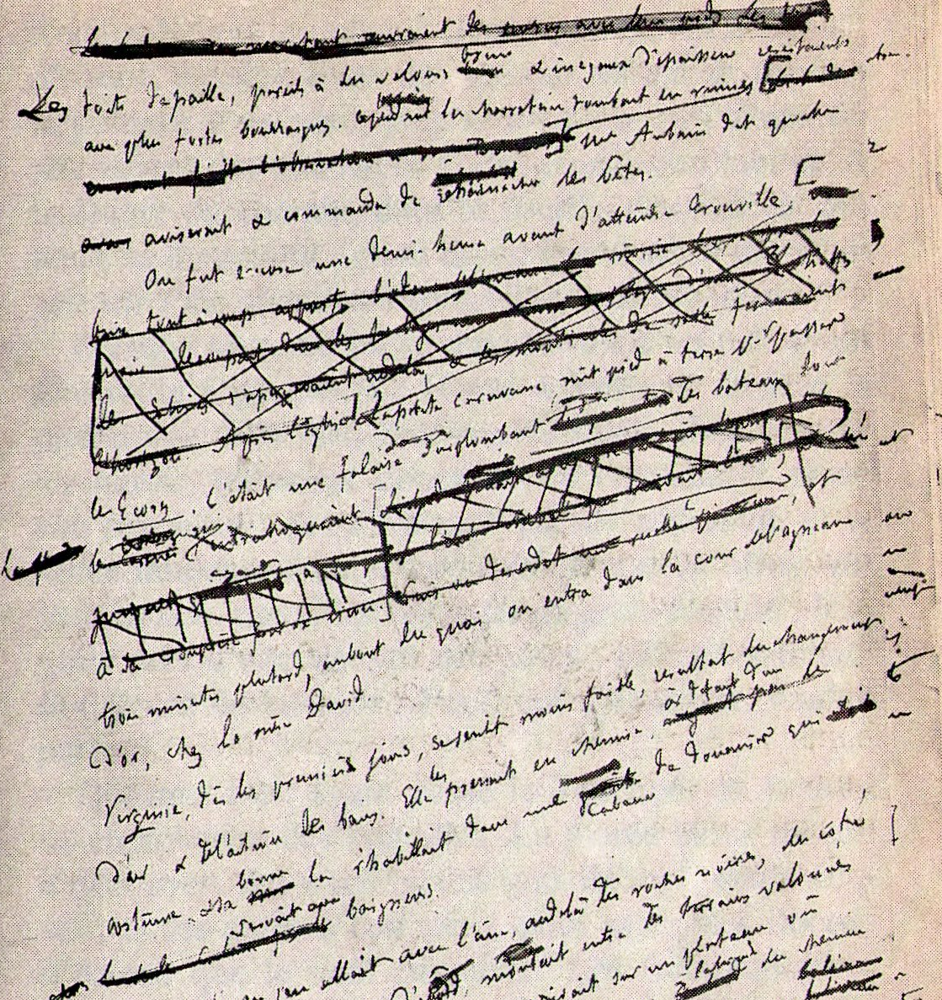
Peer Review Tips for the Reviewer
DO NOT REWRITE THE ESSAY
This is not your text. Someone else worked very hard on crafting each sentence to get to this stage in the revision process, and a reviewer must be considerate of the time and effort already put forth.
When given an essay to review, your task is to offer comments and suggestions for improvement—not including exact rewording. You may point out where some content should be reworded because the language is unclear or the diction is imprecise or too general, but as this is someone else’s essay, it is up to the author to choose those better words.
Plan your time wisely.
Do not rewrite the essay.
Offer a positive critique.
Address the author’s concerns.
Remember that this is not your paper and you do not make the decisions on what to change.
Do not reword text for the author.
Do not delete content in digital files.
Do not scribble through printed work.
What would happen if this were the author’s only copy?

Slide 4
Peer Review Tips for the Reviewer
OFFER A POSITIVE CRITIQUE
When making comments, focus on two major things:
content is development and improvement
measures against the directions and/or rubric
For content, examine information provided, but also analyze the way in which it is shared (format), the reason it is shared (focus/purpose), and the group in need of this information (audience). A peer review is not about grammar and spell check, so leave that to the author.
You want to help your classmate achieve two goals for this academic assignment:
improve his/her writing
improve his/her grade
Plan your time wisely.
Do not rewrite the essay.
Offer a positive critique.
Address the author’s concerns.
Remember that this is not your paper and you do not make the decisions on what to change.

Slide 5
Peer Review Tips for the Reviewer
OFFER A POSITIVE CRITIQUE
When offering your constructive critique, remember to do so in a positive manner. You are offering help, so do so in a way that feels like help, too. The author is trusting you to read his/her hard work in order to make it better.
For the next draft of this essay, here are some suggestions of what the author has done well and should keep:
Here are some suggestions of what the author should improve upon:
I have the following specific questions about content, format, purpose, and audience:
As I looked at the directions after reading this draft, I think the biggest improvement for the next draft could be made by:
Plan your time wisely.
Do not rewrite the essay.
Offer a positive critique.
Address the author’s concerns.
Remember that this is not your paper and you do not make the decisions on what to change.
Sometimes students like to use this framework for creating useful, but positive, critiques of their classmates’ work. Feel free to try it!

Slide 6
Peer Review Tips for the Reviewer
ADDRESS THE AUTHOR’S CONCERNS
When offering your positive constructive critique, remember that the information you provide should answer any questions the author gave you.
Sometimes peer reviews include a list of questions or topics to examine in an essay. Sometimes they do not. Most times, the author asks for a review because he/she wants assistance in making specific improvements for the next draft.
Plan your time wisely to offer a review of the essay as a whole and then to go back and review the essay as it relates to the author’s list of questions or concerns.
Plan your time wisely.
Do not rewrite the essay.
Offer a positive critique.
Address the author’s concerns.
Remember that this is not your paper and you do not make the decisions on what to change.
Examples of Author Concerns
FYI: If the list is too general, ask for clarification. You want to be a good reviewer who provides solid help. You can’t do that if you don’t understand what the author needs.
How well is my thesis supported in each body paragraph?
Is my content balanced throughout the essay, or are there places where I need to revise for supporting evidence?
Does this lead-in get your attention?
Have I explained my research adequately for a general audience?

Slide 7
Peer Review Tips for the Reviewer
WHO WROTE THIS PAPER?
Remember that this paper is not yours, and none of the final decisions about it are yours to make.
That can be frustrating, but the person earning the grade for the work on the final draft is someone else.
All of your suggestions may be accepted. Some of them may be rejected. And you may be asked for further help or clarification on your comments.
No matter what the reaction, please continue to be helpful because you’re helping yourself practice the revision process for your own essays, too.
Plan your time wisely.
Do not rewrite the essay.
Offer a positive critique.
Address the author’s concerns.
Remember that this is not your paper and you do not make the decisions on what to change.

Slide 8
Peer Review Tips for the Reviewer
Thank you for taking time out of your busy schedule to work hard to improve someone else’s writing and someone else’s grade.
Thank you for helping your classmates succeed.
I hope you also receive positive constructive criticism on your complete rough draft.
I wish you success in your writing process for all of your essays this term.
Plan your time wisely.
Do not rewrite the essay.
Offer a positive critique.
Address the author’s concerns.
Remember that this is not your paper and you do not make the decisions on what to change.

